Slide 1
AllStars Sports Bars: Website Brief
A Presentation by Bradley De’Ath (DEA18001355)
Total Word Count: 1612

Slide 2

INTRODUCTION
The University Centre Somerset has approached All Stars Sports Bar to undertake an analysis of their current website and propose recommendations to improve their online presence and business processes. They have been tasked with undertaking this analysis using technical methods and techniques to produce realistic recommendations for improvement.
Notes:
The website is an important part of any business, and so ensuring that its design and features properly represent the services offered is important. AllStars Sports Bars has tasked University Centre Somerset with analysing their current website and evaluating what changes may be needed to improve their online presence and business processes.
The aim of this presentation is to show you what has been identified through analysing the current website, along with what changes would be recommended. What methods and tools can be used to achieve these improvements will also be identified
From this analysis, anywhere the current website is limited will be identified, in terms of functionality and usability, and how the changes that have been suggested can improve users’ experiences with the site, as well as what available tools are best suited for this specific website.

Slide 3
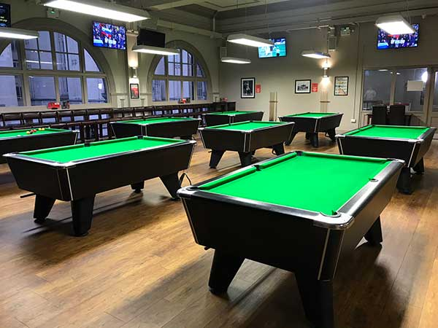
BUSINESS OVERVIEW
AllStars Sports Bars’ main clientele is those who are interested in Sports. Both those who are fans of watching sporting events on the provided TVs, and those who enjoy playing table-based sports such as Snooker
The Bars are Based In Four Locations:
Taunton (TA1 3LP)
Bristol (BS8 1QE)
Exeter (EX4 6NN)
Weston Super-Mare (BS23 1SQ)
Notes:
The All Stars Sport Bars brand is a community-focused bar that allows their patrons to relax and enjoy a wide range of sporting-related activities. From the live viewings of a wide range of sport events and a host of amusements. It is important to understand who the customers are in the business, so that the branding and websites can properly represent and relate to those who will be using it.
Throughout the wide range of locations: Taunton, Bristol, Exeter and Weston Super-mare: the aims and objectives of the business remain the same – to provide people with a place to enjoy the sports of their choice and spend time with friends.
The main clientele of the business is very sports-related: including those who are hardcore sports fans, or simply those who enjoy playing table sports (such as Snooker).

Slide 4
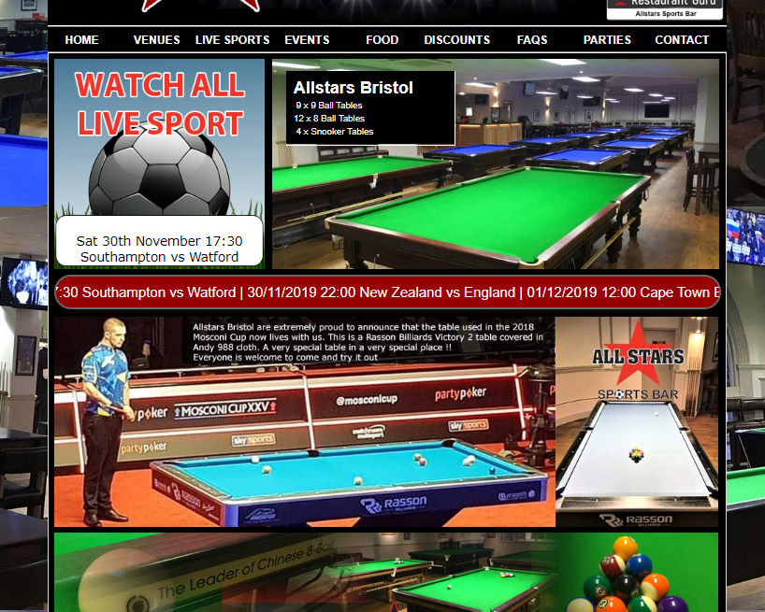
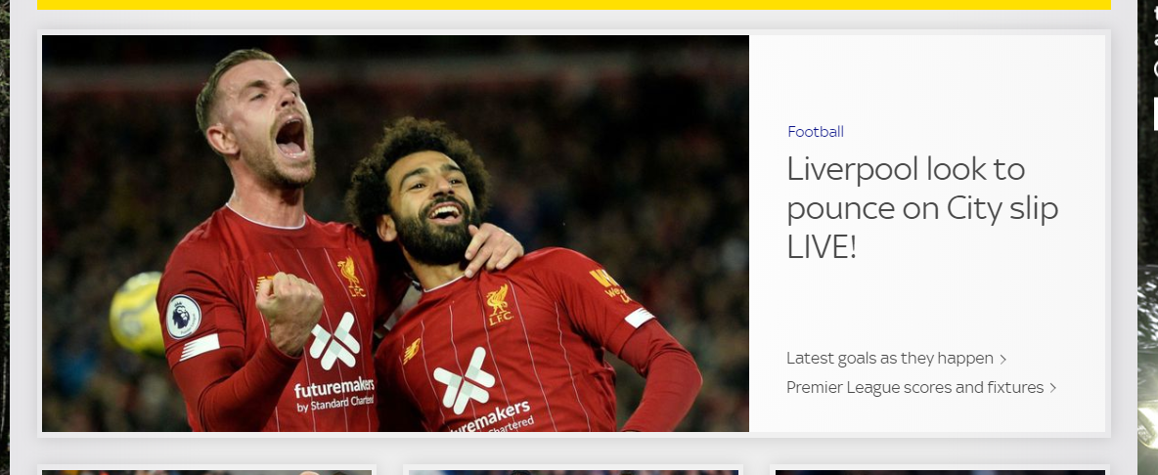
ANALYSIS OF CURRENT WEBSITE
With too many items and content on the page; it can be difficult for a user to easily find the information they are looking for. This website has a lot of information for each page and can be overwhelming.
Since it is a sport-themed business – it is important for the website to properly reflect this. This can be seen in both the screenshot of the AllStar website and the example website (Sky Sports) on the right.
Notes:
The web design principle ‘Hicks Law’ states that for each additional choice for a user to make, the longer it will take them to reach their decision. This means that having too much content on a webpage can make it harder for the user to decide what to do – making it less user friendly. The main webpage for AllStar has a lot of content, animations and detail that can easily overwhelm the user – making it harder for them to navigate to the content they need.
It is important for the design of a website to properly reflect the perspective of those who would be using it (Flavian, et al, 2009) – and the current website does meet this. The branding of the website and the bar itself heavily shows the theming of sports and entertainment throughout the content of the pages. This is especially prevalent on the front page of any of the locations selected, as it makes a point to display and advertise the different sports and activities available to customers. For example, other sports-based websites, such as Sky Sports, there is a heavy use of sport theming throughout.

Slide 5
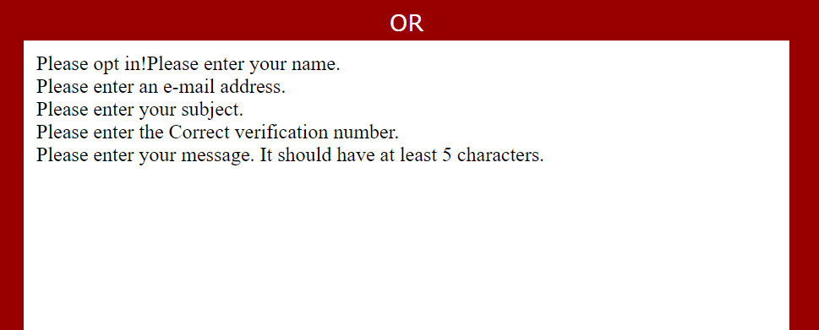
PROCESS IMPROVEMENT OPPORTUNITIES
The display when an error is entered doesn’t help the user in altering what they entered into the form, but rather removes the form entirely – requiring the user to reload the webpage.
The process of displaying upcoming sporting events to user is implemented well, as the display doesn’t take up much space on the webpage yet still conveys all of the information
Notes:
When it comes to providing services to customers, business processes are the individual steps that make up the delivery of the final service. As previously mentioned, one of the process that are offered to customers is the ability to contact a member of staff with any queries. This is an important process for companies to provide, as reducing confusion about the business can help increase the number of patrons. This process is offered through the ‘Contact’ page of the website and allows users to fill out a form to submit their request. While this process is useful, the design used on the website is one that can be improved. If an error is made by the user when filling out the form, the request is not sent and the form is replaced with an unfriendly piece of text that states there has been errors, but doesn’t allow for them to be corrected – instead requiring the user to reload the webpage entirely.
Another current business process is the display of upcoming sports events that can be viewed. Since most customers will attend this bar with the intention of watching live sporting events, having a display of which events will soon be available can be helpful when attracting customers.

Slide 6
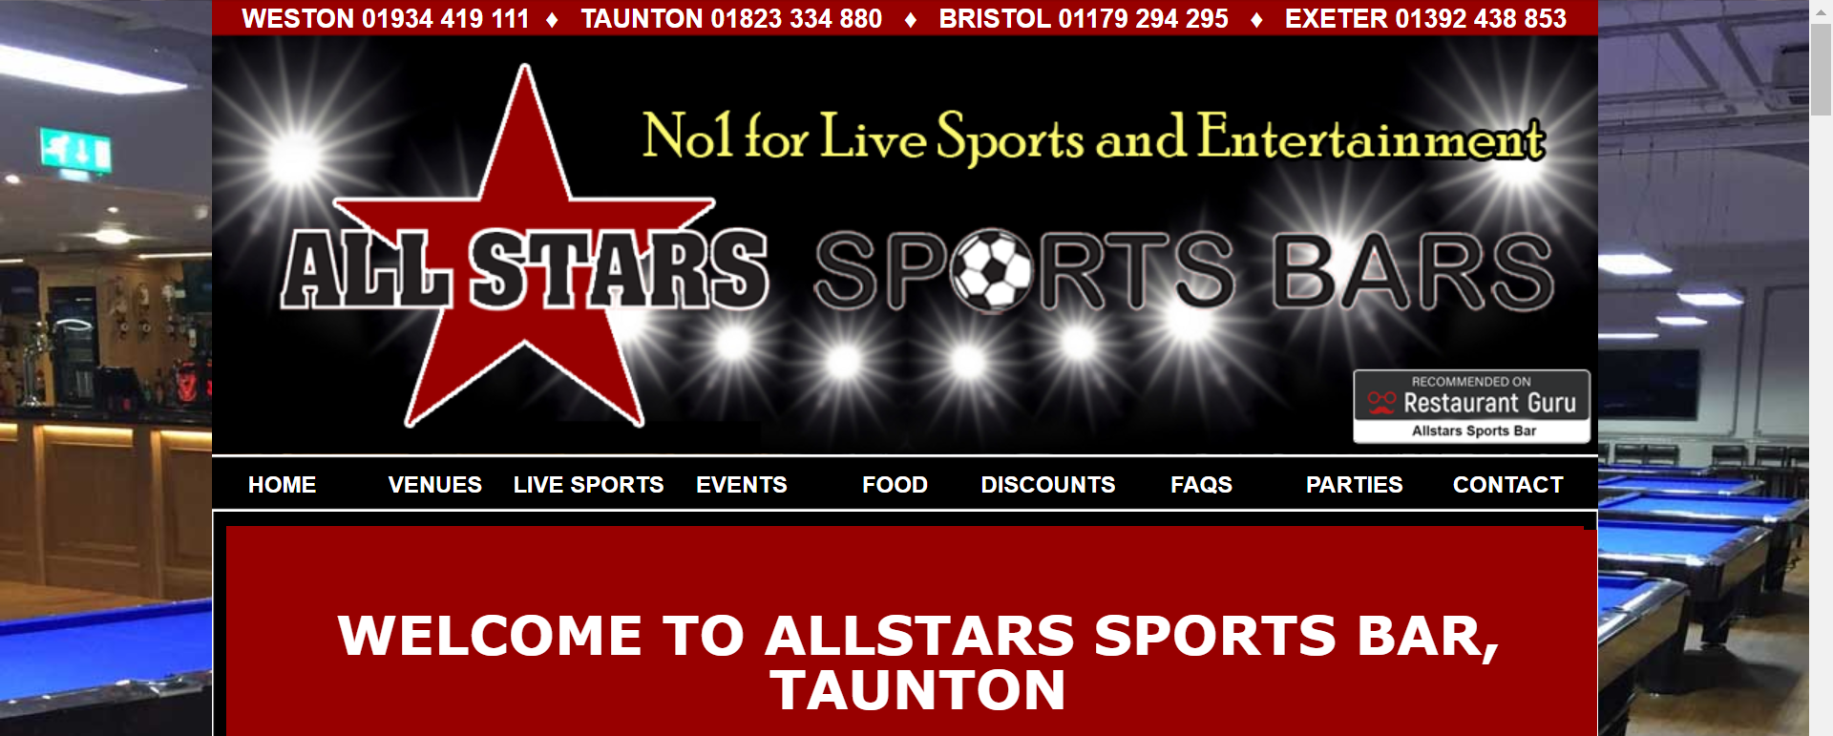
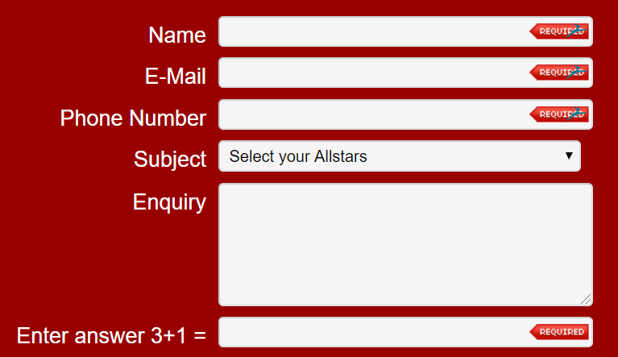
RECCOMENDATIONS
With the use of pictures on each side of the website content, the text is given less space and so instead of extending the entire width of the browser window: has to go further down in length, forcing the user to have to scroll more to read everything.
Its important for websites to implement methods to stop their services being spammed by automated submissions and requests. With the contact page having the same mathematical question for every form that’s submitted, the measure can be easily bypassed.
Notes:
When navigating a website, having the user keep scrolling and navigating to read of the content can become annoying and tedious. For AllStars, many of the webpages are very long lengthwise and require the user to keep scrolling. A recommendation for improvements would be to shorten the length of the pages, and to move any important information further up. This means that users can more easily find and view specific content they may be looking for, along with be more easily accessible for all users.
Another recommendation to improve the website is to fix security on the ‘Contact Us’ page. To prevent spam on requests for queries from users, a maths question is asked to prove that the one entering the form is a real person instead of a computer. However, the mathematic question never changes – and so once the answer is known it can be easily exploited/automated. Having a randomly generated question helps prevent these spam attacks.

Slide 7
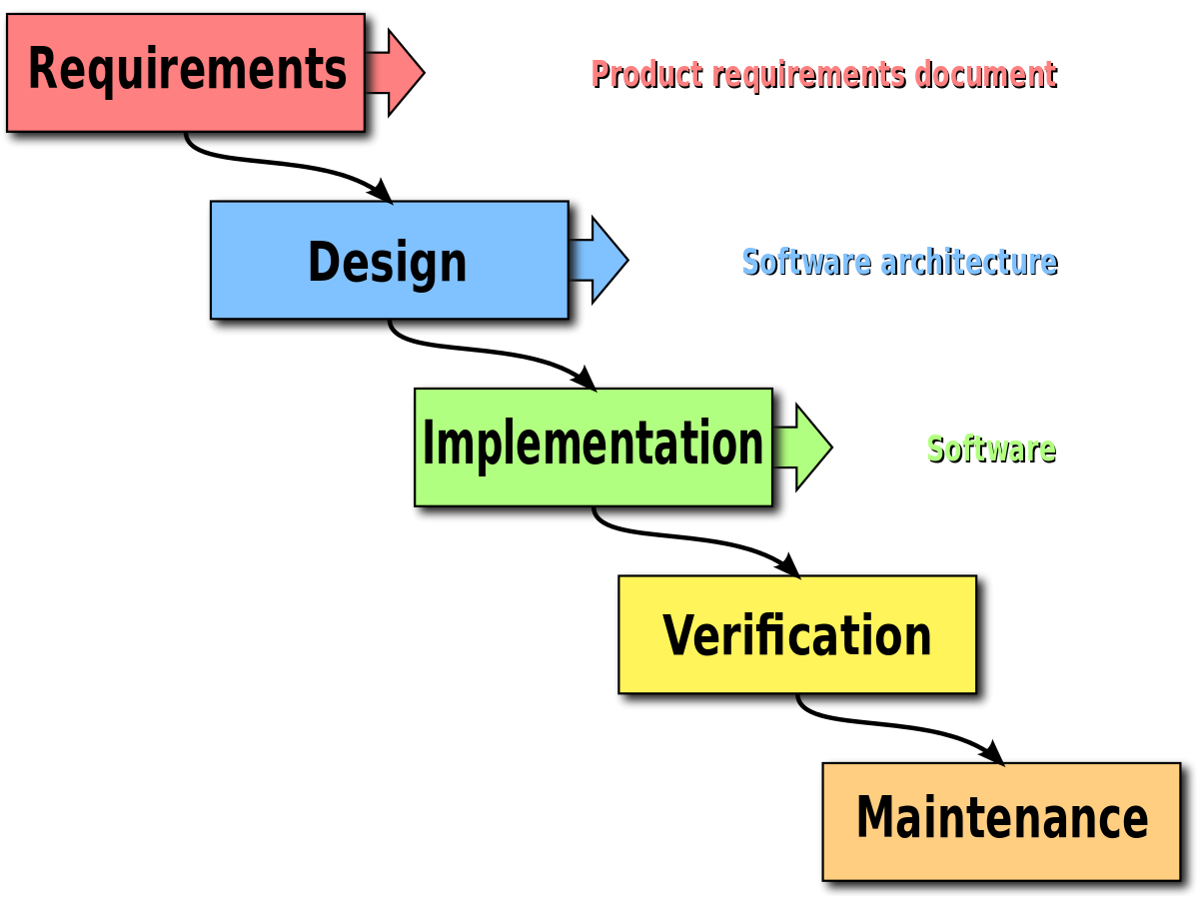
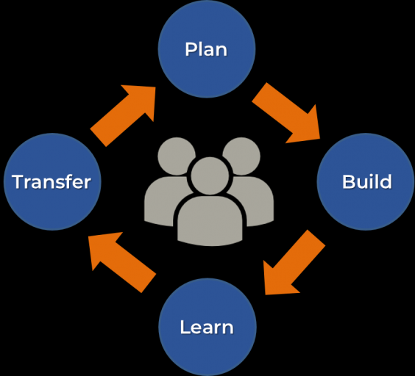
PROPOSED WEB DEVELOPMENT METHODOLOGY
The Continuous Development Cycle works like a loop, where after each change is implemented, feedback is gathered on it and is considered before proceeding further
The Waterfall Methodology is very linear and requires each prior task to be completed before the next can be started. Feedback about features cannot be worked on until the entire product is complete
Notes:
The methodology of designing a website is essentially the template and structure for how you will go about completing the tasks at hand – that is why it is important to ensure the correct one Is chosen, to save any unnecessary issues during development. That is why The Continuous Development Cycle has been chosen for the development of this website, as a large part of its design revolves around adaptability.
The Continuous Development Cycle is based around small, constant developments to a website based on feedback and data that is received. So that while the website is being created, feedback can be considered before the entirety of the website is created. This means that not too much backpedalling is required to make changes, as little progress will have been made before the feedback is received.
This is the chosen methodology, as opposed to the waterfall method, feedback is considered well before the final product is produced.

Slide 8
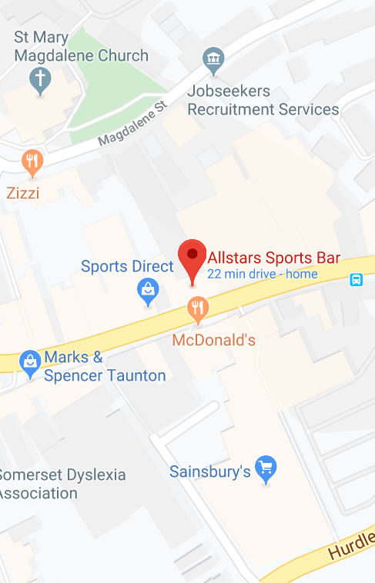
WEB DEVELOPMENT TOOLS EVALUATION
Web Development IDEs are essential when making any website – and so choosing the correct one is important. Different IDEs can hold different features and benefits, so some are suited for certain websites than others. For example, the Brackets IDE contains colour coded text for different commands and content type; making important code easily identifiable.
There are many tools that are not as essential as the IDE. One such tool is the ability to integrate Google Maps directly into the code of a website. This is especially useful for this website as it can help customers locate the different AllStars sports bars
Notes:
There are a range of tools available when developing a website, and arguably one of the most important are the IDEs. An IDE is an Integrated Development Environment and is essentially where the coding and development is done to produce the website. Brackets, for example is a commonly used IDE. Brackets contains a large library of HTML and CSS elements – and can help users select the right one. This is because it presents users with tags as they type, like an autocorrect feature, so less tags need to be typed in full, the IDE itself can hold them all for the user.
Another example of a commonly used IDE is that of Notepad ++. Notepad ++ is simpler in design, as it presents the user with a plain environment for the code to be entered. However, it doesn’t store a library of the languages (HTML, CSS, etc.) and so requires the user to enter tags in full, it also doesn’t automatically check for syntax errors.

Slide 9

WEB FRAMEWORKS EVALUATION
Using a web framework when developing a website means that the process can be made more efficient and easier. Through using the styling sheets included in frameworks, such as bootstrap, users don’t need to do all their styling from scratch. This makes it not only easier for newer developers, but also allows for the overall styling to be completed quicker.
One of the main benefits of the Siimple framework is that it is modular. This means that the user only needs to import the CSS styling that they need for the objects their using, as opposed to importing the entire CSS file(s) and only using parts of them. One of the positives of this feature is that it can reduce the space taken up by the website as not as much styling code is needed.
Notes:
A commonly used web framework is Bootstrap, which is a package of web development code (primarily HTML, CSS and Java) that use classes to help style and layout the pages of a website. This Framework allows developers to assign Bootstrap classes to elements – that have CSS styling pre-designed and will lay out and format the webpage based on which classes are assigned by the user. This is suitable for the development for this website, as the professional look and layout can benefit the overall feel of the site.
Another commonly used Framework is Siimple, which is based around the idea of clean and simple web pages. While this framework is popular, the complexity required for the AllStars website makes it not suitable for use in this context, as it lacks many of the design classes required to format so many unique elements.

Slide 10


SELECTION OF WEB DEVELOPMENT TOOLS AND FRAMEWORKS
The chosen IDE for the development of the website is Brackets. This IDE contains a strong error-checking system as well as a display that is colour-coded and so easier to search through. With this display ability, larger websites’ code can be easier to manage and navigate.
The chosen Framework for this website is Bootstrap. With the large amount of customisation presents and options, the website can achieve a more professional and consistent look quicker, with no extra strain on the developers.
Notes:
For the web development tools, the chosen IDE to use is Brackets, this has been chosen due to it being more efficient for the web programming. The implementation of the error-checking feature means that any issues within the code can be identified easier and without the need to check every individual line of code for any syntax errors. As well as this, Brackets has an extensive Library within it. Being able to have tags autocompleted as well as automatic closing tags being added can save a lot of time in developing and can help avoid errors.
For the framework, Bootstrap has been chosen to be used. This framework’s ability to make the styling of websites easier and look more polished can make it more professional looking in less time. When using Bootstrap, you aren’t just limited to the exact style set on the styling page. Whether through an additional CSS page or modifying the existing one: the design can be more suiting to the site.

Slide 11
CONCLUSION
Key Points:
The AllStar website has a lot of content on each page, which can be overwhelming for the user
The current website uses theming well, clearly showing that sports is heavily involved with the business
The current website is too long vertically and doesn’t make proper use of width space
The current website’s security for contacting staff is very weak
The Continuous Development Cycle Methodology will be used for the development of the new site
The Brackets IDE will be used for the development of the new site
For the styling of the website, the Brackets Framework will be used
Notes:
This presentation has highlighted and explained both strengths and weaknesses of the current AllStar website, along with how the weaknesses could be improved. Through the evaluation of different tools and frameworks, proper improvements can be made to the website to better different aspects. With the importance of features such as security and user friendliness; the correct changes can be made.
The next step of the development of this website is to begin creation of UX and UI diagrams. From wireframes to in-depth prototypes – these UX and UI tools can be used to create a stronger idea of what the new website would look like and how it would function.
The UI design/prototype will be based off the UX wireframes, which will display a simple layout of where all content would be located on the website and what their purpose is. These diagrams will better display how the analysis from this PowerPoint will be used to influence the development of the website.

Slide 12
REFERENCES
Allstarssportsbars.co.uk. (2019). Allstars Sports Bars. [online] Available at: https://www.allstarssportsbars.co.uk/home/ [Accessed 30 Nov. 2019].
Flavian, C., Gurrea, R. and Orús, C. (2009). Web design: a key factor for the website success. Journal of Systems and Information Technology, 11(2), pp.168-184.
SkySports. (2019). Home (Sky Sports). [online] Available at: https://www.skysports.com/ [Accessed 30 Nov. 2019].
Brackets. (2019). A modern, open source code editor that understands web design. [online] Available at: http://brackets.io/ [Accessed 30 Nov. 2019].
Google Maps. (2019). Google Maps. [online] Available at: https://www.google.com/maps [Accessed 30 Nov. 2019].
Mark Otto, a. (2019). Bootstrap. [online] Getbootstrap.com. Available at: https://getbootstrap.com/ [Accessed 30 Nov. 2019].
Siimple.xyz. (2019). siimple: minimal and responsive CSS Framework for flat and clean designs | siimple. [online] Available at: https://www.siimple.xyz/ [Accessed 30 Nov. 2019].
Notepad-plus-plus.org. (2019). Notepad++. [online] Available at: https://notepad-plus-plus.org/ [Accessed 3 Dec. 2019].

